Slide 1

Project 1: Book REPL
Seth Loyd

Slide 2
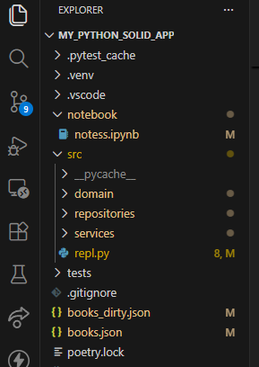
Architecture
Using SOLID principles, I separated the project into different sections
The different sections have specific jobs
The layers allow for easier readability and changeability.

Slide 3
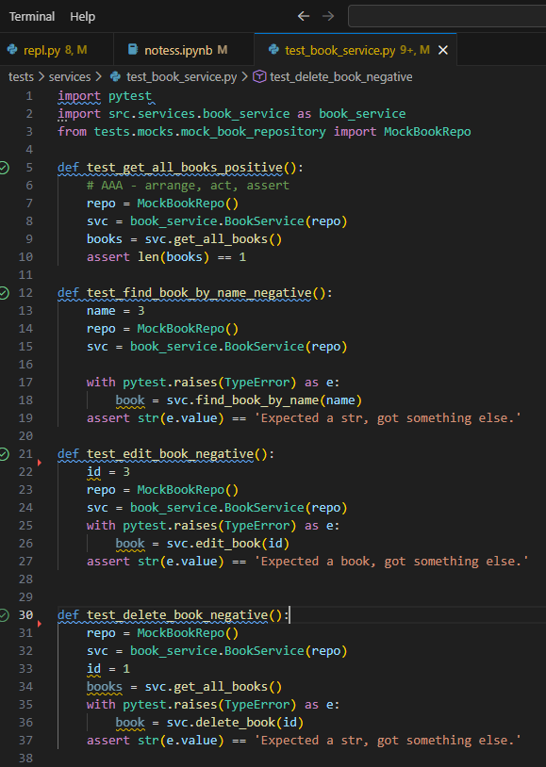
Unit Tests
Unit tests are in tandem with pytest
Mock repository created to insure separation from real repo.

Slide 4
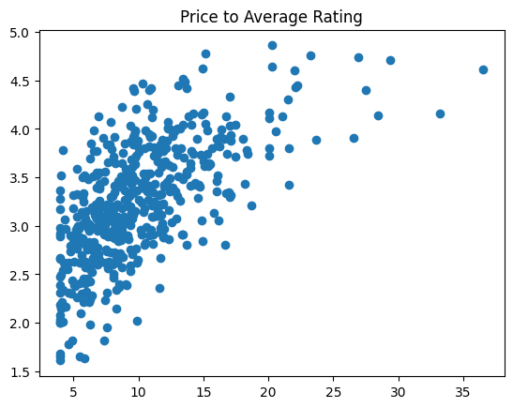
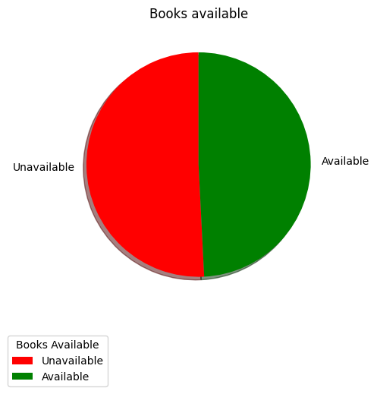
Analytics
Used Matplotlib with NumPy and Pandas for analytics generation.

Slide 5
Demo

Slide 6

Thank you!

